Slide 1
SAP EWM EXTENDED WAREHOUSE MANAGEMENT TRAINING
AnubhavTrainings.com
www.anubhavtrainings.com

Slide 2

SAP EWM TRAINING
BY:-
Mr. Bijoy
www.anubhavtrainings.com
Notes:
https://unsplash.com/photos/uXB-7la5vqA

Slide 3
SAP EWM TRAINING (Day 07)
AnubhavTrainings.com

Slide 4
Inbound Process / Putaway Process
Delivery document types for Inbound, Item types for Inbound,
Putaway strategies, Storage type Search, Stroage section search, Storage bin determination
End to End Inbound process – testing execution
Complex putaway strategy

Slide 5
EWM PACKAGING SPECIFICATION
Contents
A packaging specification is master data. The packaging specification defines all the necessary packing levels for a product for example to put away or transport the product. For a product, a packaging specification mainly describes in which quantities you can pack the product into which packaging materials.
Use
For automatic HU creation
In printed form, a packaging specification is a set of instructions for the employee in the warehouse. More specifically, the work steps that you enter in a packaging specification are intended as information for the employee. For example, give the employee exact instructions as to where to place the label on a box, or how a product should be stacked onto a pallet. The system can determine packaging specifications during various processes. Processes that determine packaging specifications use only specific attributes from the packaging specification.
Maintain structure of packaging specifications starts with header, contents, Level type, element type, level set, define work step, and define packing material type. In order to understand structure of pack spec see below figure.

Slide 6
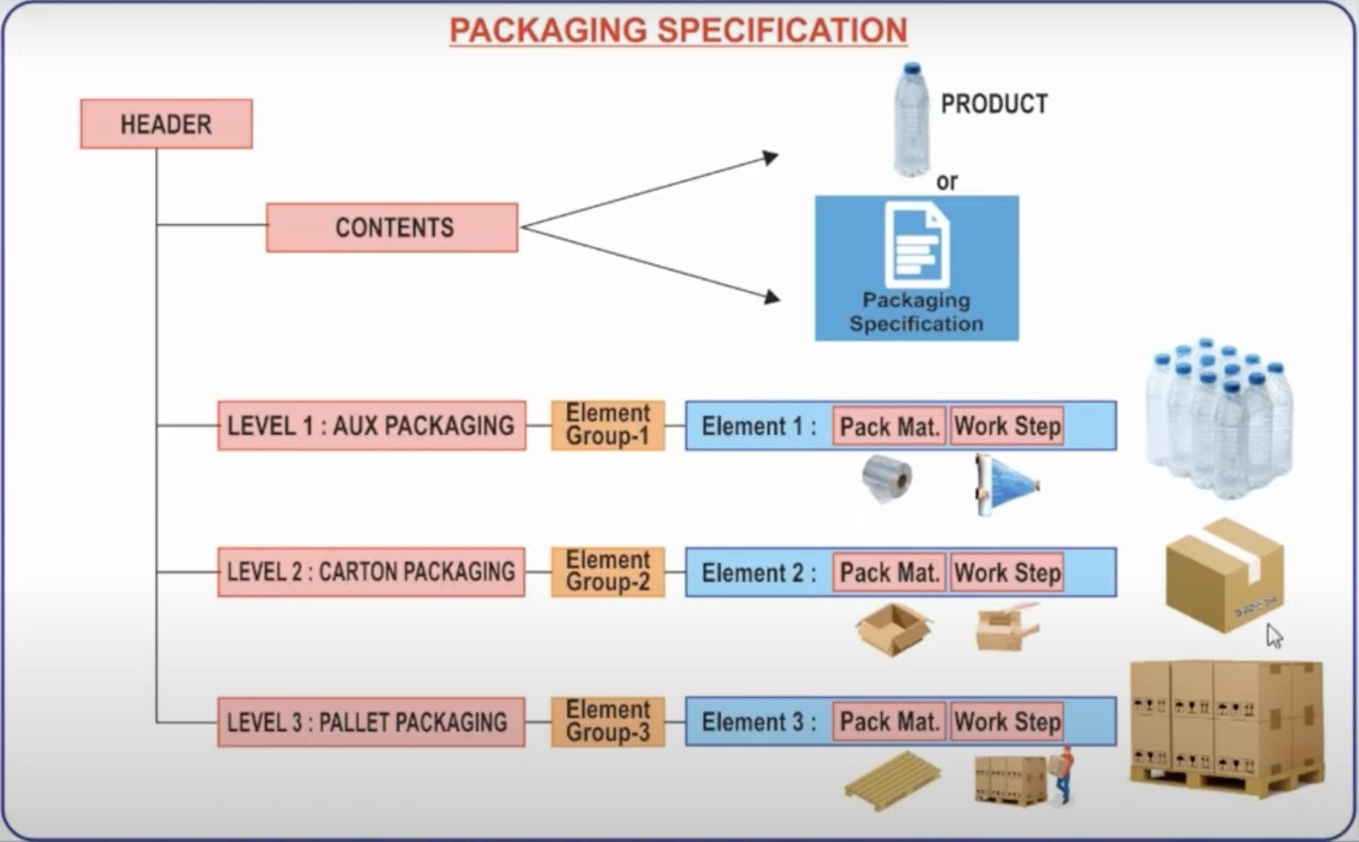
Maintain structure of packaging specifications starts with header, contents, Level type, element type, level set, define work step, and define packing material type. In order to understand structure of pack spec see below figure.

Slide 7
Example for a packaging specification and its structure
Header: Name: Pack Spec X
Contents: product X, 1 each
Level 1: Target quantity one, element group EG1
Element group EG1:
Element E1: packaging material ‘Carton box’, work step ‘Place 1 Each upright in each box’
Level 2: Target quantity 100, element group EG2
Element group EG2:
Element E2: packaging material ‘Pallet’, work step ‘Place boxes layer by layer onto pallet’
Packaging specifications can be created, copied, activated and determined using condition technique

Slide 8
Contents
Assign Packaging Material Type To Element Type
Define Packaging Specification Group
Maintain The Master Data By /Scwm/Packspec

Slide 9
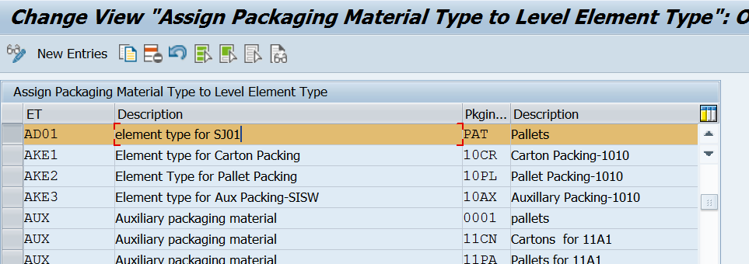
ASSIGN PACKAGING MATERIAL TYPE TO ELEMENT TYPE
www.anubhavtrainings.com

Slide 10
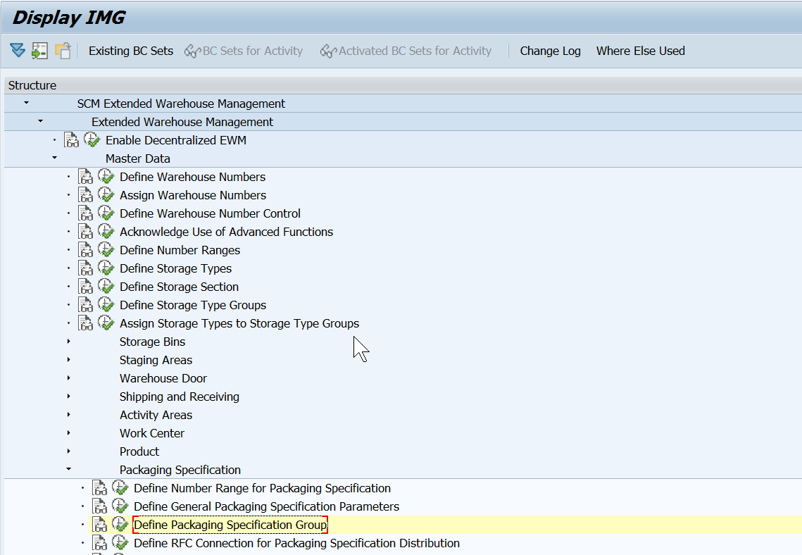
Define Packaging Specification Group
www.anubhavtrainings.com

Slide 11
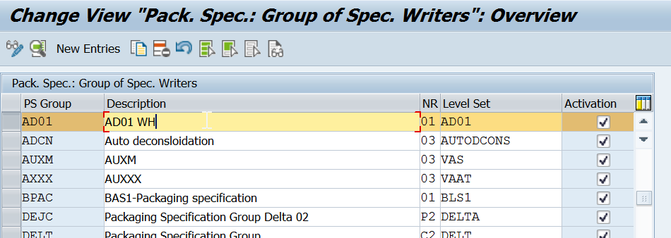
www.anubhavtrainings.com

Slide 12
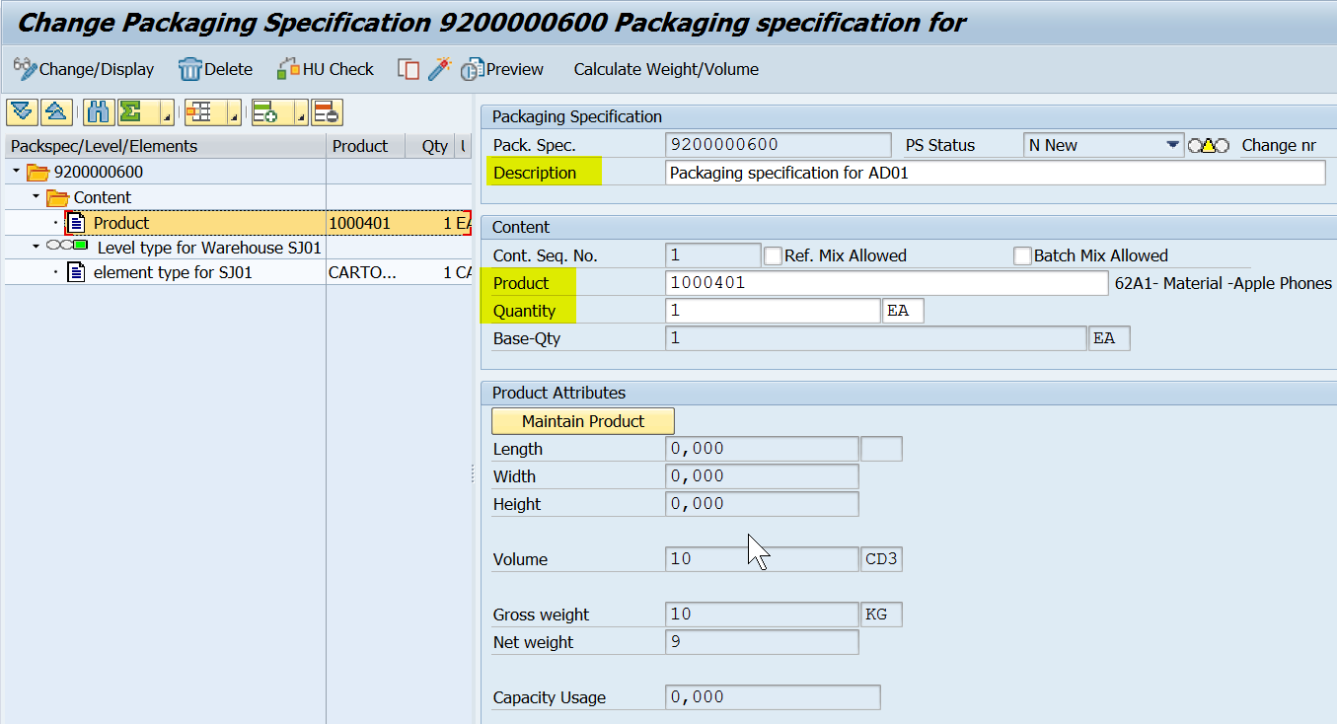
www.anubhavtrainings.com

Slide 13
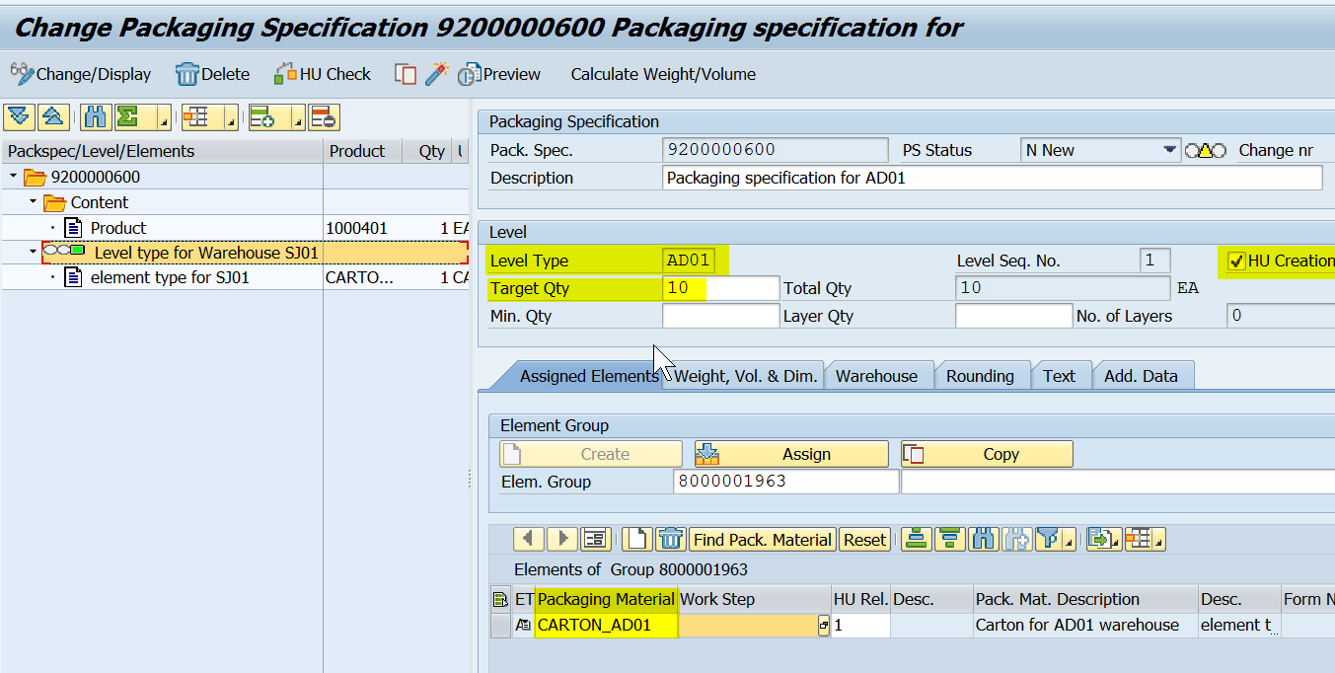
www.anubhavtrainings.com

Slide 14
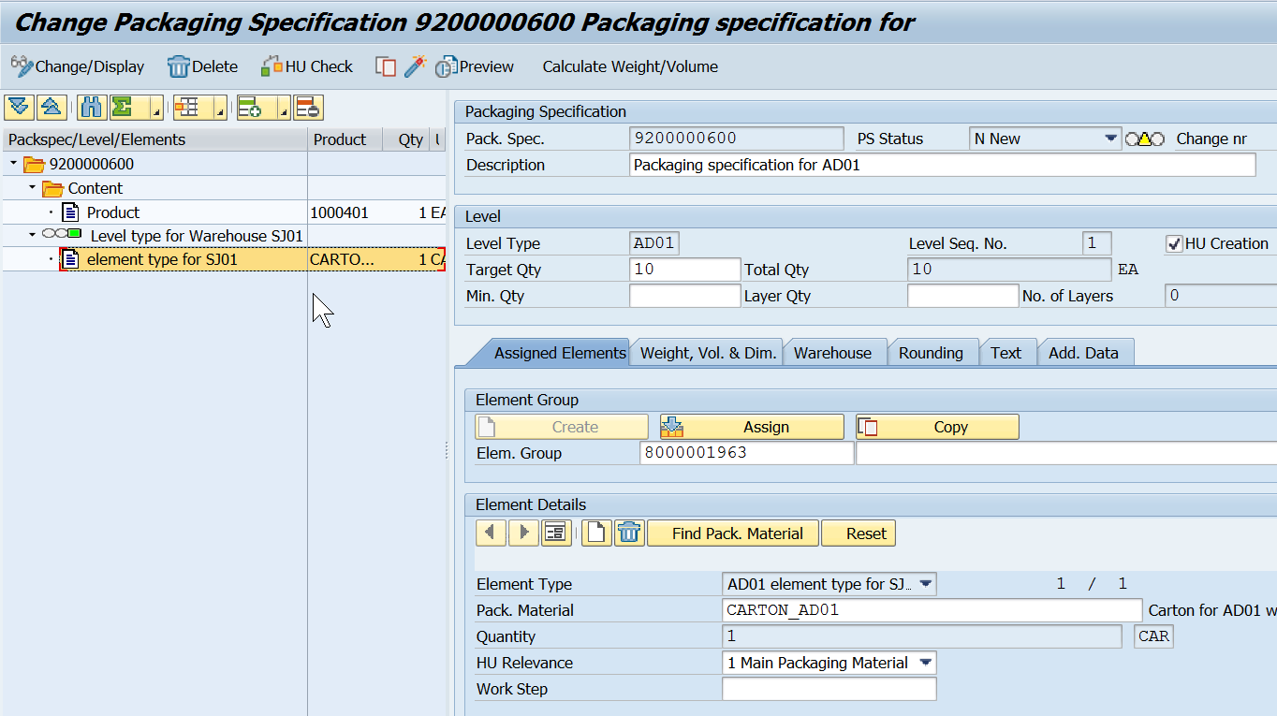
Enter the details and activate the Object.
Mass upload of Packaging specifications - /scwm/ipu
www.anubhavtrainings.com

Slide 15


End of Session 07
www.anubhavtrainings.com

Slide 16

FEEL FREE TO ASK QUESTIONS

Slide 17

Feedback

Slide 18
THANK
YOU

Slide 19

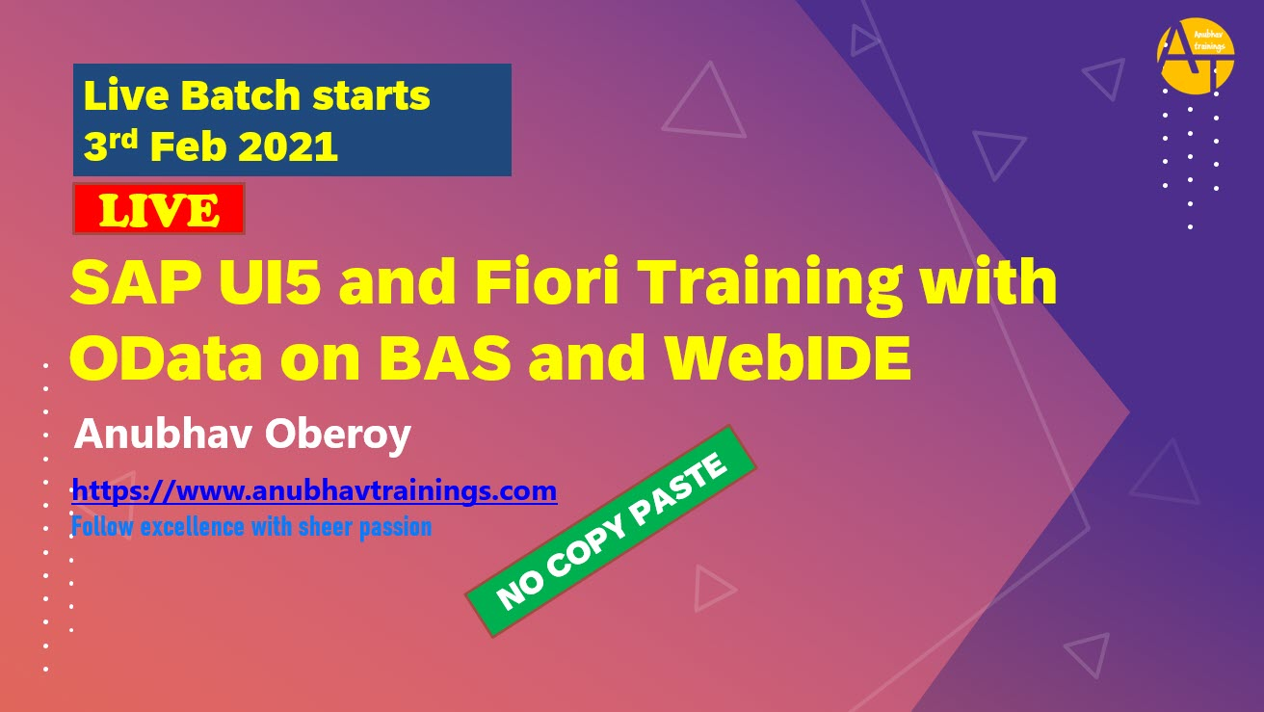


More from AnubhavTrainings.com

Slide 20






We’re committed to empower you to be
#FutureReady
through powerful training solutions.
We build the workforce of the future.
250+
Corporate Clients
30,000+
Learners Trained
25000+
Learners Placed
FREE WEBINARS
Sign up for free webinars with industry experts every fortnight!
Enroll Now!

Slide 21
FREE WEBINARS
Sign up for free webinars with industry experts every fortnight!
Contact us today!
www.anubhavtrainings.com

